Slide 1
K-W-L Chart: Skeletal System
Make a K-W-L Chart about the Skeletal System
K= What you know already
W = What you would like to know
L = What you learned today (this will be filled in at the end of class)

Slide 2
Skeletal System
Chapter 16 (pages 301-310)

Slide 3
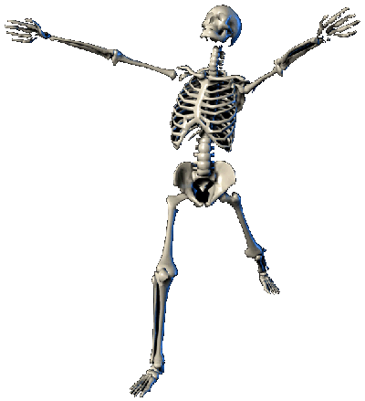
Bones
Living tissue (hard form of connective tissue)
Chief supporting tissue of body
Provide:
PROTECTION for vital structures
SUPPORT for body
Mechanical basis for MOVEMENT
STOREHOUSE for minerals
Continuous supply of new blood cells (PRODUCTION)
Notes:
Minerals: calcium and phosphorus which can be supplied to other parts off body; when mineral present in excess in blood, buildup will occur within the bones; when supply low, they will be withdrawn from bones to replenish supply
Blood cells: average of 2.6 million RBC produced eache second by bone marrow; these celss are used to replace worn out and destroyed by liver

Slide 4
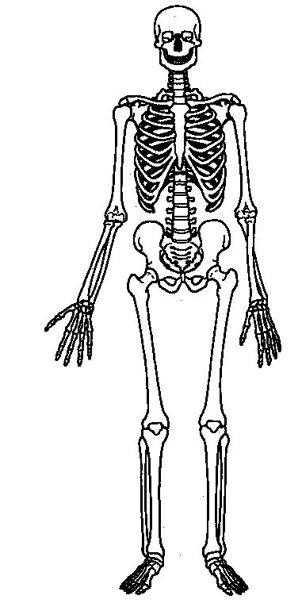
Skeleton
Total 206 bones
Babies born with 270 soft bones; by adulthood these 64 bones will have fused together into hard, permanent bones.

Slide 5
Bone Anatomy
Types
Flat
Irregular
Short
Long
Structures
Diaphysis
Epiphysis
Articular cartilage
Periosteum
Medullary cavity

Slide 6
Types of Bone
Flat
Thin, flattened, and usually a bit curved
Serve protective function
Scapula, sternum, ribs, most bones of skull
Irregular
Have weird shapes that do not fit other 3 classes
Vertebrae, hip, 2 skull bones (sphenoid, ethmoid bones)
Short
Cube-like in shape
Found in carpals (wrist) and tarsals (ankle)
Long
Much longer than they are wide
All bones of limbs (except patella, carpals, tarsals)
Consists of shaft plus 2 expanded ends

Slide 7
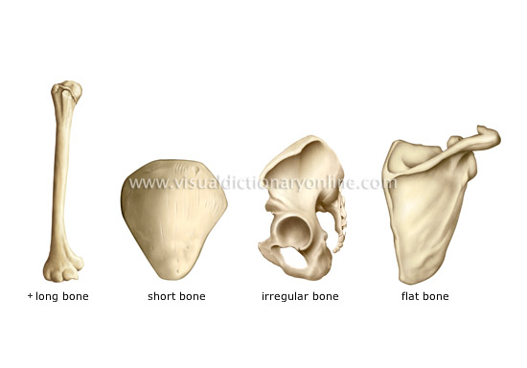
Types of Bone

Slide 8
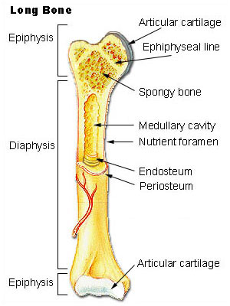
Structure of a Long Bone
Diaphysis: shaft of long bone
Epiphysis: end of a long bone
Articular Cartilage: covers bearing surface of bone
Periosteum: fibrous tissue that covers the bone
Medullary Canal: center of the shaft
Notes:
See p. 90 in instructors manual

Slide 9
Bone Formation/Growth
Osteocyte: bone cell
Ossification: the process of bone formation
Bones grow in length and ossify from the center of the diaphysis toward the epiphyseal extremities
Osteoblast: bone cells that build bone
Osteoclast: bone cells that reabsorb bone
Notes:
Bones consist of microscopic cells called osteocytes; made up of 35% organic material, 65% inorganic mineral salts, and water; organic part derives from a protein called bone collagen

Slide 10
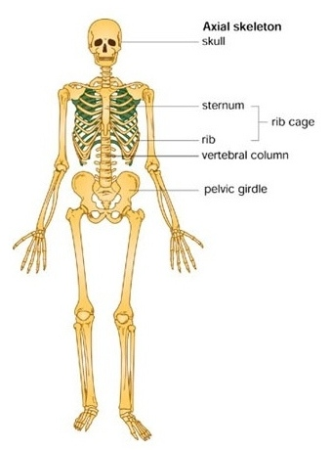
Axial Skeleton
80 bones
Bones of:
Head (skull)
Neck (spine)
Trunk (sternum, ribs)

Slide 11
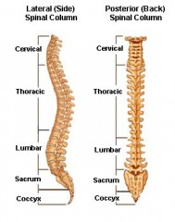
Spinal Column
Cervical
Thoracic
Lumbar
Sacrum
Coccyx
Notes:
THIS SLIDE NEEDS WORK!!

Slide 12
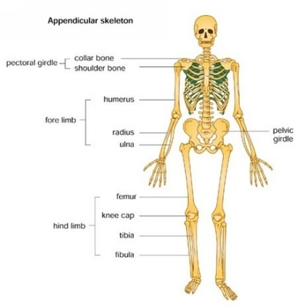
Appendicular Skeleton
126 bones
Bones of:
Pelvis
Shoulder girdles
Limbs

Slide 13
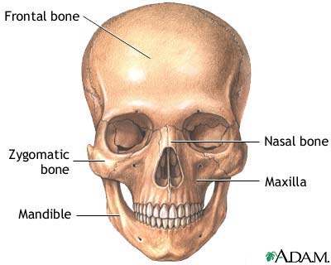
Skull
Skull

Slide 14
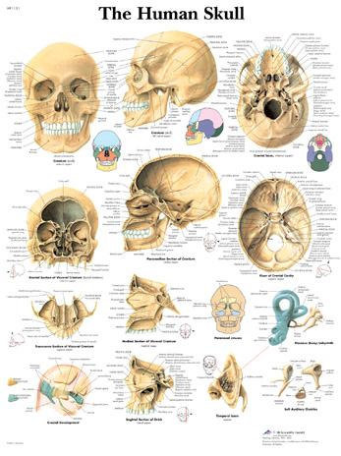

Slide 15
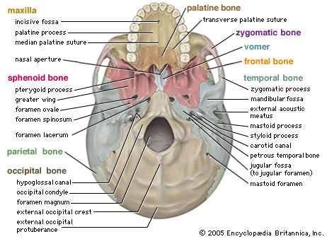

Slide 16
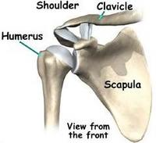
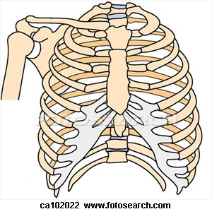
Shoulder

Slide 17
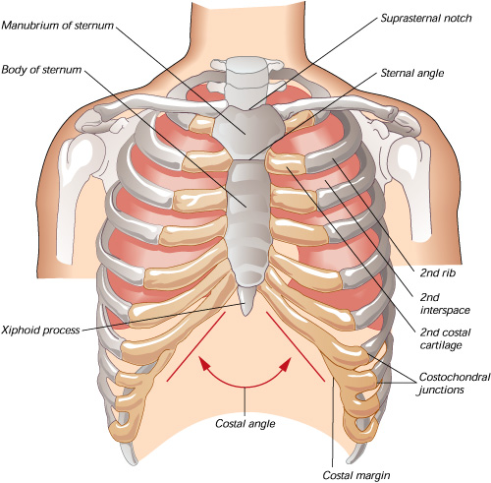
Chest
Sternum
Ribs

Slide 18
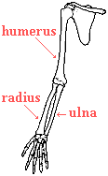
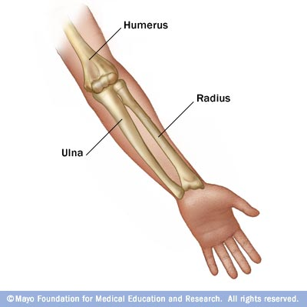
Arm

Slide 19
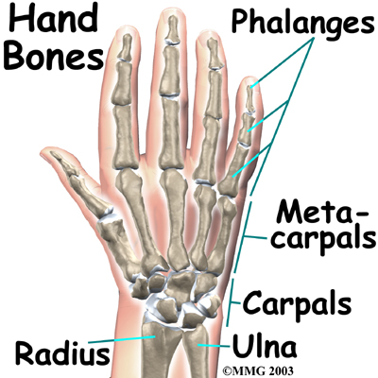
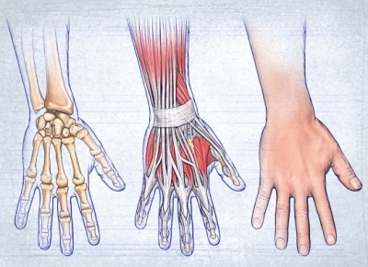
Hand

Slide 20
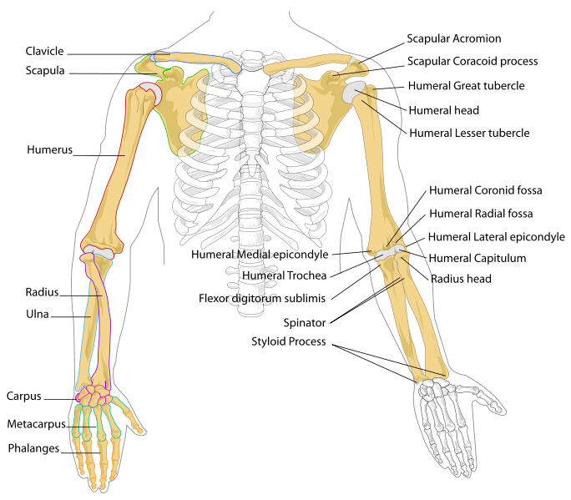
Upper Extremity
Clavicle
Scapula
Sternum
Ribs
Humerus
Radius
Ulna
Carpals
Metacarpals
Phalanges

Slide 21
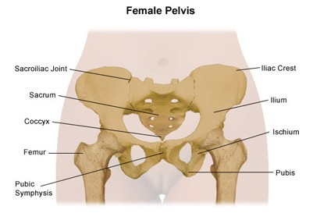
Spine/Pelvis
Pelvis
Sacrum
Pubic Bone/
Pubis
Sacrum
Pubis

Slide 22
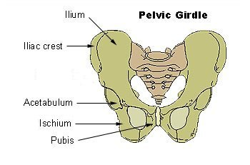
Os Coxa

Slide 23
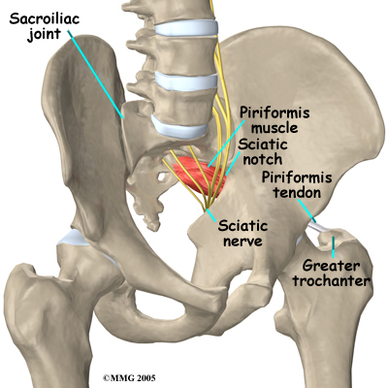

Slide 24
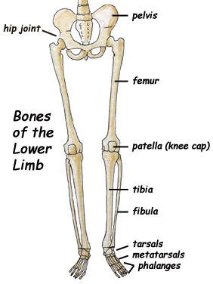
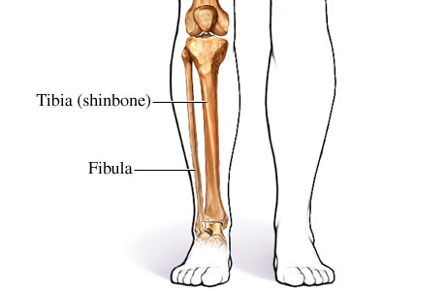
Leg

Slide 25
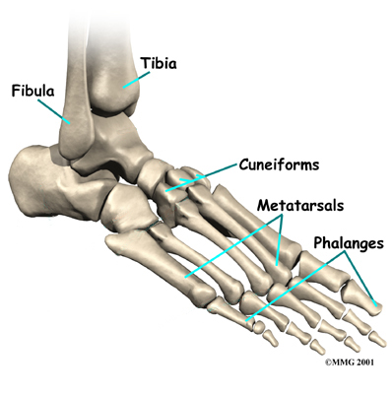
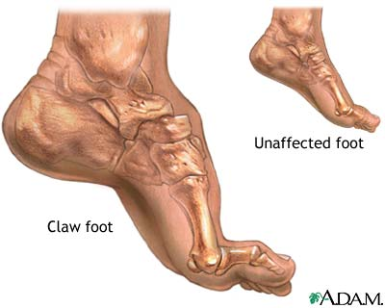
Foot
Tarsals

Slide 26
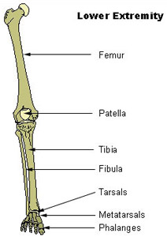
Lower Extremity

