Slide 1
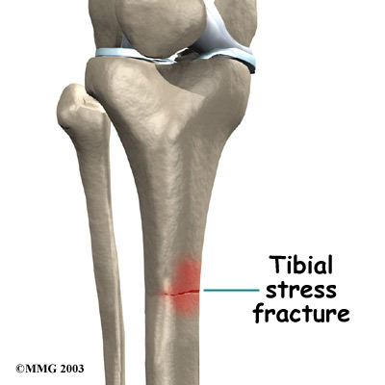
Stress Fracture
Small incomplete break in bone due to:
Overuse
Poor muscle balance
Lack of flexibility
Weakness in soft tissue
Biomechanical problems
Malnutrition
Stresses on body are greater than body can compensate
Symptoms
Pain
Tenderness after activity
No or little pain in AM,
but pain returns after activity

Slide 2
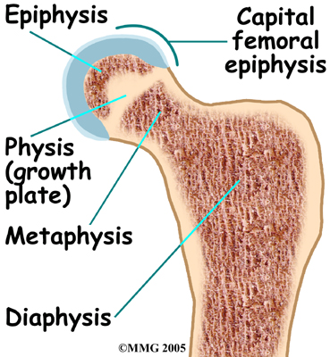
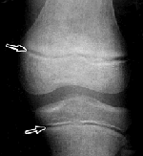
Epiphyseal Plate Fracture
Break in bone at growth plate
Most in individuals (age 10-16) due to sports participation
X-ray won’t show fx of epiphyseal b/c epiphyseal plate shows up clear

Slide 3
Fractures
Signs & Symptoms
Swelling (edema)
Deformity
Pain
Tenderness
Discoloration
Loss of function
Treatment
Internal fixation
External fixation
Remodeling: process of absorbing and replacing bone
Notes:
Remodeling: process of healing bone often occurs naturally

Slide 4
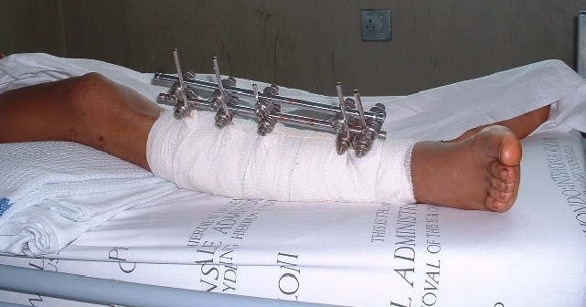
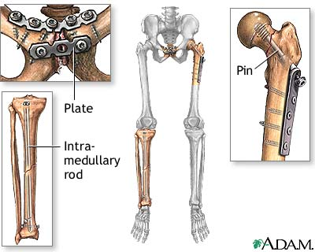
Treatment & Repair
Internal Fixation
Surgery required to align bones and reduce fracture
External Fixation
Use of cast to keep bones aligned while natural healing occurs

Slide 5
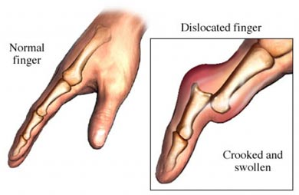
Skeletal Injuries
Subluxation
Occurs when bone displaces, then returns to normal position
Dislocation
Occurs when significant force displaces bone so that the two bone ends in a joint no longer add up

