Slide 1
Warm-up 9/2/16
What does ATC stand for? When can a person use this designation beside their name?
What type of school can a person graduate from to be eligible to take the certification exam? (community college, high school, 4-year college or university)
What does NATA stand for, in what year was it formed, and what is their importance to athletic training?
Explain who the Cramer family is and their role they have played in athletic training.

Slide 2
Employment Settings
Secondary Schools
School District
College/University
Professional Teams
Sports Medicine Clinic
Industrial Setting
Hospital/Outreach
Non-traditional

Slide 3
Secondary Schools
Hired by the hospital and contracted to a high school.
Works the second half of the day.
Not at school all day.
Provide limited coverage

Slide 4
School Districts
Centrally placed ATC
May be full- or part-time
Non-teacher who serves several schools
Advantage = savings
Disadvantage = lack or inadequate coverage/service

Slide 5
Colleges/Universities
Small Institutions
Part-time teacher, part-time athletic trainer
Multiple sports
Also provide coverage to intramurals & club programs
Long hours
Limited resources
Major Institutions
Full-time athletic trainers
Works only for dept of athletics
One sport
Long hours!
Abundance of resources, personnel

Slide 6
Sports Medicine Clinics
More ATCs employed in this setting than in any other
Varies from clinic to clinic
Most ATCs treat patients with sports-related injuries in am & contract out to high schools in pm
Salaries are typically slightly higher than in more traditional settings
May be responsible for marketing of sports medicine program

Slide 7
Professional Teams
Perform specific team athletic training duties for 6 months per year
Works with only one team or organization
Under contract, similar to players

Slide 8
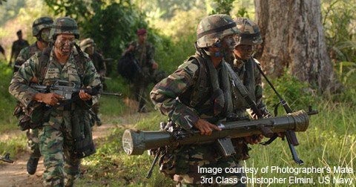
Industrial/Military
Becoming common for ATC to work in a prevention role
Oversee fitness and injury rehabilitation programs for employees
Must understand concepts behind ergonomics
May be assigned to conduct wellness programs & provide education and individual counseling
Also employed by federal law enforcement agencies (i.e.. FBI, CIA, DEA)

Slide 9
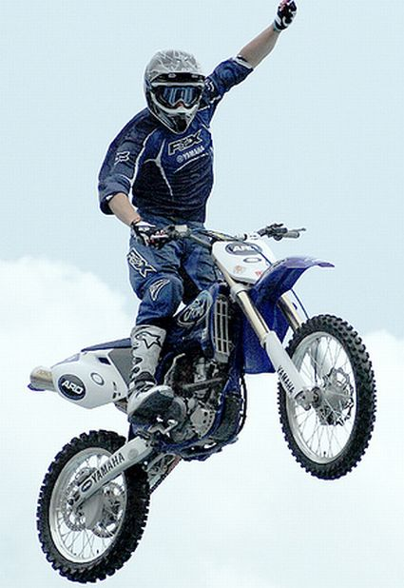
Non-Traditional
X-Games
Dance company
Notes:
Name other areas an AT could be useful
Dance (rocketts)
X-Games
Movies

Slide 10
Working Relationship:
Administrators
Athletic Personnel
Parents
Allied Health Professionals

Slide 11
Exit Pass
Choose one employment setting if you were an athletic trainer and explain why you would want to work in that setting.
Must be 5 sentences

