Slide 1
Ipsilateral/Contralateral
Ipsilateral—on the same side as another structure
i.e. the left arm is ipsilateral to the left leg.
Contralateral—on the opposite from another structure
i.e. the left arm is contralateral to the right arm, or the right leg.

Slide 2
Superficial/Intermediate/Deep
Superficial—near the outer surface of the body
i.e. skin is superficial to the muscle layer
Intermediate—between two other structures
i.e. the naval is intermediate to (or intermediate between) the left arm and the contralateral (right) leg.
Deep—further away from the surface of the body
i.e. the muscular layer is deep to the skin, but superficial to the intestines.

Slide 3
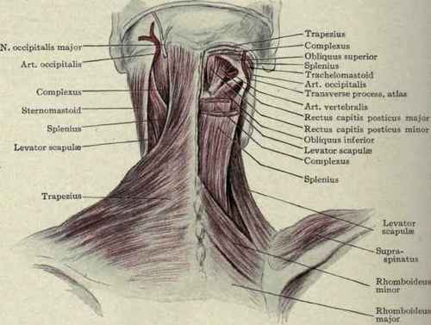
Superficial/Intermediate/Deep

Slide 4
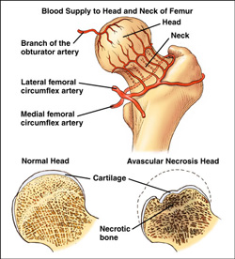
Avascular
Without blood circulation

Slide 5
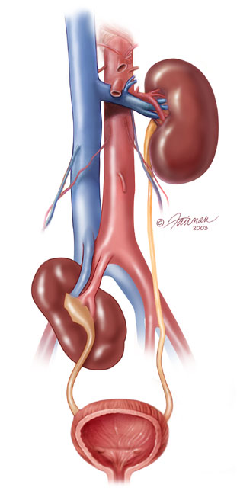
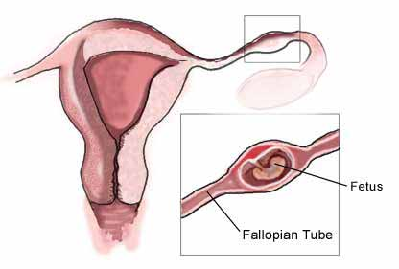
Ectopic
Occurring in an abnormal position or place
Notes:
Ectopic pregnancy=a complication of pregnancy in which the pregnancy implants outside the uterine cavity
Ectopic kidney=not located in the usual position

Slide 6
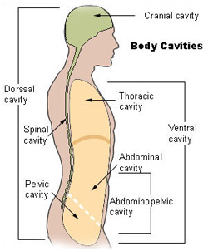
Body Cavities
Thoracic Cavity
Abdominal and Pelvic Cavity
Dorsal Cavity
Notes:
6

Slide 7
Thoracic Cavity
Upper ventral, thoracic or chest cavity
Contains:
Heart
Lungs
Trachea
Esophagus
Large blood vessels
Nerves
Bound laterally by ribs and the diaphragm caudally

Slide 8
Abdominopelvic Cavity
Lower part of ventral cavity
Abdominal:
Gastrointestinal tract
Kidneys
Adrenal glands
Pelvic:
Urogenital system
Rectum
Notes:
8

Slide 9
Dorsal Cavity
Smaller of two main cavities
Upper portion:
Cranial cavity
Brain
Lower portion:
Vertebral canal house spinal cord

Slide 10
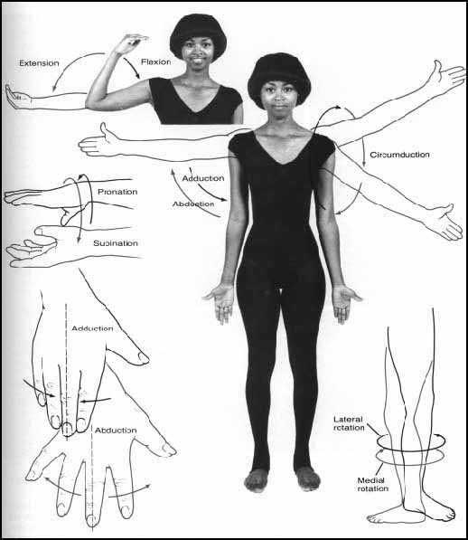

Slide 11
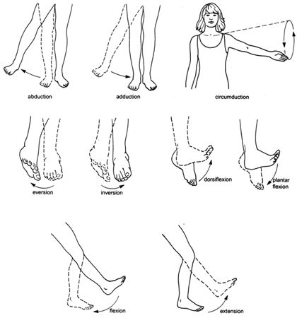

Slide 12
