Slide 1
Warm-up 9/1/16
What is the process to become an ATC?
Name two ways to obtain CEU’s.
Explain what Title IX is. Do you agree with this legislation? Give supporting evidence to argue your opinion.

Slide 2
Roles and Responsibilities of the Athletic Trainer (6 domains tested)
Preventative
Recognition, Evaluation, and Immediate Care
Rehabilitation Course of Action
Administration
Professional Development
Personal Skills

Slide 3
1. Preventative
Pre-Participation Screening (PPE)
Conditioning
Total body
Sport or injury specific
Monitoring Environmental Conditions
Field conditions
Weather
Properly Fitted Equipment
Educate
Parents, coaches, athletes

Slide 4
2. Recognition, Evaluation, and Immediate Care
Emergency
Acute
Course of Action
Notes:
Think quickly, calmly
Initial Eval:
Rule out ER conditions
Transport off field? How?
Return to play? Referral?
Safety first!!

Slide 5
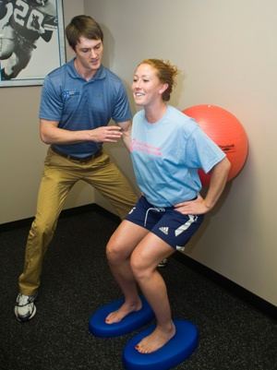
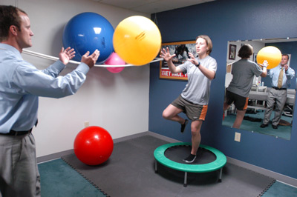
3. Rehabilitation Course of Action
Short Term
Long Term
Return to Play
Notes:
Communicate with physician

Slide 6
4. Administration
Documentation
Daily records
Treatment logs
Insurance
Family history
Medications
Surgeries
Written Guidelines
Policy and Procedures
Daily operations
Rules/regulations
EAP
Scheduling

Slide 7
5. Professional Development
Membership in Different Professional Organizations
Stay current
CEU
Be active in organizations
Notes:
CEU’s awarded for attending symposiums, seminars, workshops, conferences; serving as a speaker, panelist, or certification exam model; authoring a research article in a professional journal, authoring or editing a textbook; completing a JAT quiz; obtaining CPR, first aid, or EMT certification.
All ATC must demonstrate proof of CPR certification at least once during 3 year term

Slide 8
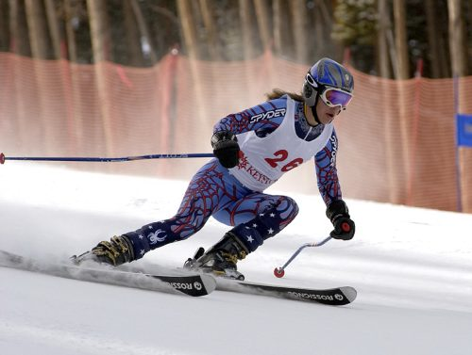
6. Personal Skills
1. Know the Athlete:
Medical History past/current
Injuries, allergies, meds, contact lens, dental appliances
Personality
Low tolerance vs. high tolerance
2. Know the Sport:
Fundamentals
Demands of sport
Same injury
In one sport not cleared,
in another
can play

Slide 9
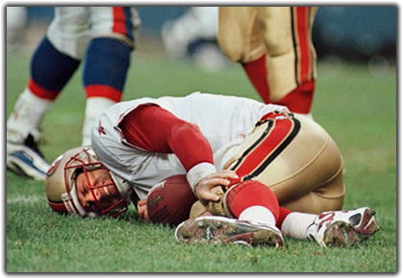
Personal Skills cont.
3. Remain Calm:
Self calm
Calm the athlete
Very difficult to assess if the athlete is scared, excited, and anxious
4. Alert:
Observe all athletes
Limping, down, acting unusual
5. Good Judgment:
Common sense

Slide 10
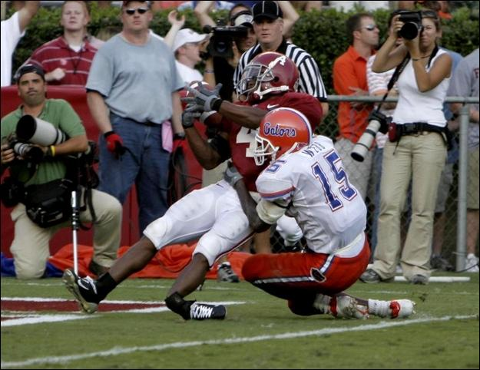
Personal Skills cont.
6. Experience:
Confidence
Assessment skills
7. Patience (with):
Evaluation
Athlete
Self
Notes:
Learn from experience, don’t dwell
Don’t be afraid to refer, could be more serious than initially thought

Slide 11
Personal Skills cont.
8. Referral:
Record all information
Send to physician
Doubts, concerns
Clearance

Slide 12
What personal qualities make a good Athletic Trainer?
Empathy
Flexibility
Ability to adapt
Stamina
Ability to communicate
Personability with athletes
Listener (counselor)
Common sense
Good judgment
Intellectual curiosity
Education
Experience
Confidence
Patience

Slide 13
Required Skills
Problem solving ability
Deductive reasoning skills
Good judgment
Good decision making skills
Proficient knowledge of anatomy, physiology, biology, and advanced first aid
Motor skills
Communication skills
Ability to work well with people
Ability to work well under stressful conditions
Ability to maintain poise in emergencies

Slide 14
Lets talk about it…
TITLE IX
Each group will be told to be on the side for or against this federal law.
Once you are told which side to be on, your group will be given 5 mins to develop 4 statements that supports your side.
Share out with the class.

Slide 15
Exit Pass
Explain what a pre-participation examination is.
Why is knowing the fundamentals of each sport important to know as an ATC?

