Slide 1
Warm-up 1/30/17
List 3 responsibilities you think an Athletic Trainer should have.
What is the importance of the sports medicine team (aka: athlete circle of care)? Which member has the ultimate decision on the athlete’s return to play status?
Do you think it should be mandatory for high schools to have an Athletic Trainer on staff? Why or Why not?

Slide 2
So you think you want to be an Athletic Trainer?
https://www.youtube.com/watch?v=VCyR8Aoi6c8

Slide 3
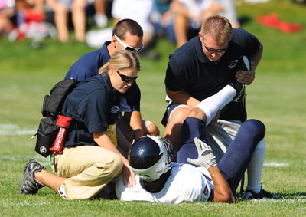
Athletic Trainer
Preventing injuries from occurring
Providing initial first aid and injury management
Analyzing and evaluating injuries
Taping and bandaging
Implementing exercise and rehabilitation programs for athletes
Using various modalities and training equipment
Recording, organizing, and
storing information on injuries
and rehabilitation
Notes:
Rehab program: timely and effective program for safe and efficient return to sport

Slide 4
Requirements for Certification
Must graduate from an undergraduate or graduate program accredited by the Commission on Accreditation of Allied Health Education Program (CAAHEP)
Pass certification examination
Maintain certification with continuing education
Notes:
CEUs to ensure ongoing professional growth and involvement by ATCs (50/ 2 year)

Slide 5
Core Curriculum
Human anatomy
Human physiology
Psychology
Kinesiology
Biomechanics
Exercise physiology
Personal community health
Nutrition
Prevention of athletic injuries/illness
Evaluation of athletic injuries/illness
Therapeutic modalities
Therapeutic exercise
Administration of athletic training programs

Slide 6
Core Curriculum cont.
First aid and emergency care
General medical conditions and disabilities
Health care administration
Medical ethics and legal issues
Pathology of injury/illness
Pharmacology
Professional development and responsibilities
Psychosocial intervention and referral
Risk management and injury/illness prevention
Strength training and reconditioning
Statistics and research design
Weigh management and body composition

Slide 7
Purpose of Certification
To test standards for entry into the profession of athletic training
Standards set by the National Athletic Trainers’ Association Board of Certification (NATABOC) www.nataboc.org
Notes:
NATA Code of Ethics

Slide 8
Certification Examination
Fulfill requirements
Tested in 6 domains:
Prevention of athletic injuries
Recognition, evaluation & assessment of injuries
Immediate care of injuries
Treatment, rehabilitation, & reconditioning of athletic injuries
Health care administration
Professional development & responsibility

Slide 9
Intro Notes Foldable
Athlete’s Circle of Care
Careers (minimum of 6)
Orthopedist
Sports Nutritionist
Exercise physiologist
Physician’s Assistant
Certified Athletic Trainer
Certification Process
Responsibilities
Places of employment
Associations
Name
Year
Importance
Other
Trainer’s Bible
Laws
Cramer Family

Slide 10
Exercise physiologist
One who significantly influences the athletic training program by giving input to the athletic trainer regarding training and conditioning techniques, body composition analysis, and nutritional considerations.
Orthopedist
An individual responsible for treating injuries and disorders of the musculoskeletal system
Physician’s Assistant
A mid-level health care practitioner who works interdependently with physicians to provide diagnostic and therapeutic care.

Slide 11
Exit Pass
List the steps to become an ATC.
How many CEU’s must an ATC have to renew their certification?
List 2 class that an athletic training student might take.

