Slide 1
Warm-up: Concept Map
Create and complete the following concept map. Use the information that you may already now or learned yesterday from the video.
What is it? What do they do?
Importance?
Athletic Training
Where can they work?
Name 3 other careers related to athletic training.

Slide 2
Unit 1: Table of Contents
1.1 Warm-ups
1.2 Part 1 Notes
1.3 Part 2 Notes
1.4 Part 3 Notes
1.5 Part 4 Notes
1.6 Ch.1 Analysis
1.7 Ch.2 Analysis
1.8 Vocab. Matching Worksheet
1.9 Article Review/ Case Study
1.10 NATA Web Quest
1.11 Support Personnel WS
1.12 Study Guide

Slide 3
The Athletic Trainer and the Sports Medicine Team
Introduction

Slide 4
Sports Medicine
Athletic Training
Biomechanics
Exercise Physiology
Medical Practice
Physical Therapy
Sport Nutrition
Sport Psychology
Massage Therapy

Slide 5
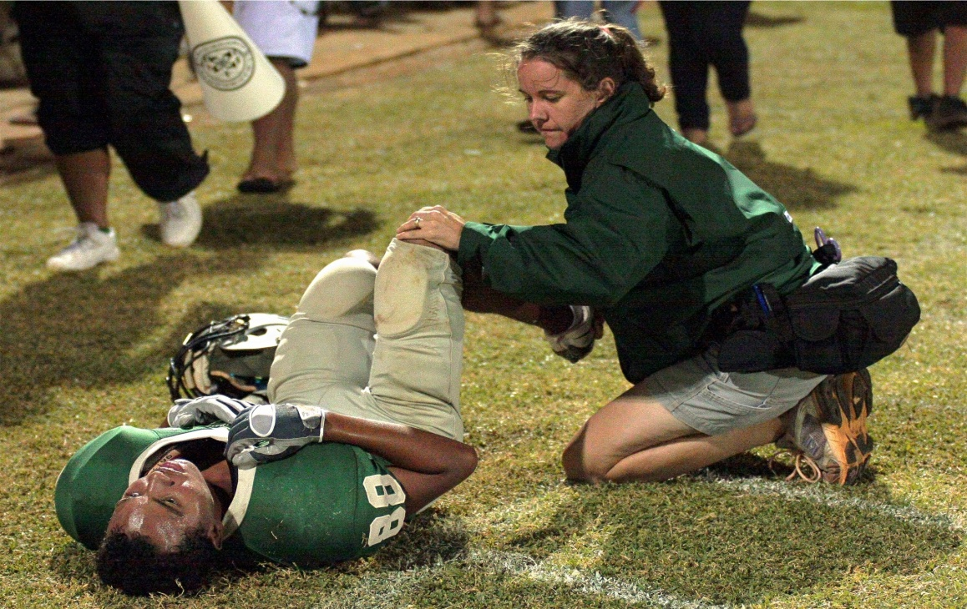
Sports Medicine Team:
Team Physician—absolute authority in determining participation status
Athletic Trainer
Coach
Athlete
Notes:
Group effort is most effective
Athlete circle of care: athlete reports to the coaching staff with medical complaint; coaching staff refers athlete to AT staff for tx; AT staff asses injury and if needed refer athlete to family/team doctor, staff also communicates with athletes parents; athlete may be referred to specialist prn; treatment monitored by AT staff; AT staff communicates with coaching staff on athlete’s status

Slide 6
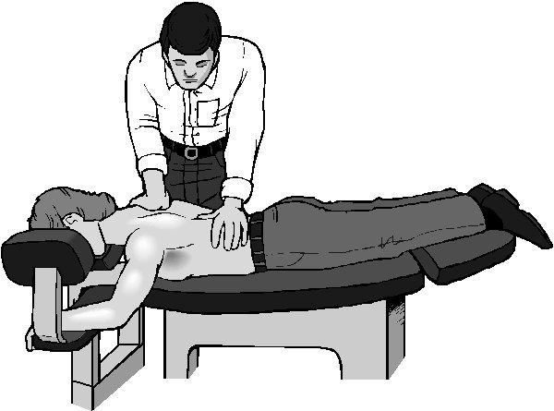
Professions Associated With Sports Medicine
Family Doctor
Certified Strength and Conditioning Specialist (CSCS)
Chiropractor
Massage Therapist
Physician’s Assistant

Slide 7
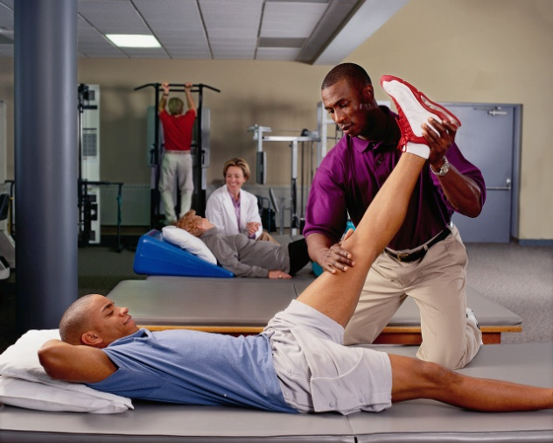
Associated Professions (cont’d)
Physical Therapist
Physical Therapist Assistant
Sports Nutritionist
Sports Psychologist
National Strength and Conditioning Association Certified Personal Trainer (NCSA-CPT)

Slide 8
Athletic Training & the ATC
The rendering of specialized care (prevention, recognition, evaluation and care of injuries) to individuals involved in exercise and athletics.
Certified Athletic Trainer: highly educated and skilled professional who specializes in the prevention, treatment, and rehabilitation of injuries

Slide 9
Title IX
Federal legislation in effect since 1972
Prohibits discrimination in school athletic participation on the basis of sex
Tremendous increase in female athletic participation, creating an even greater need for qualified certified athletic trainers

Slide 10
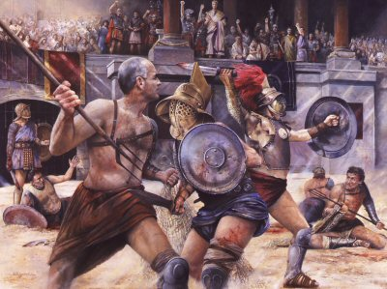
History and Development of Athletic Training
Galan, gladiators in ancient Rome
Renaissance, human body actively studied
Leonardo da Vinci, great contributor during Renaissance
19th century firm establishment of intercollegiate & interscholastic sports
The Trainer’s Bible
1917, Dr. S.E. Bilik
First major text on athletic training
and the care of athletic injuries
Notes:
Greek and Roman civilizations, coaches, trainers, physicians; roles starting to emerge
For centuries after fall of Roman empire (Middle Ages) there was complete lack of interest in sports activities
Beginning of Renaissance activities slowly gain popularity
19th century: no technical knowledge, athletic training techniques usually consisted of a run, the application of some type of counterirritant, and occasionally the prescription of various home remedies and poultices

Slide 11
History and Development of Athletic Training
Cramer Family (1920s)
Gardner, Kansas
Started a chemical company and began producing a liniment to treat ankle sprains
Publication of First Aider in 1932
Family instrumental in early development of the athletic training profession
Continue to play prominent role in education of student athletic trainers
Notes:
Cramer’s realized there was market for products to treat injured athletes; in effort to enhance communication and facilitated exchange of ideas among coaches, athletic trainers, and athletes=publication

Slide 12
History and Development of Athletic Training
1950: NATA formed, establishing professional standards for the athletic trainer
1991: American Medical Association (AMA) recognized athletic training as allied health profession
Notes:
1930s effort made to establish a national organization, then WWII
1947-1950: university athletic trainers once again began to organize themselves into separate regional conference, which would later become what we know now as districts
1991: taken many years for the athletic trainer to attain the status of a well-qualified allied health care professional
AT will continue to evolve as long as athletes continue to compete and injuries continue to occur

Slide 13
Lets talk about it…
TITLE IX
Each group will be told to be on the side for or against this federal law.
Once you are told which side to be on, your group will be given 5 mins to develop 4 statements that supports your side.
Share out with the class.

Slide 14
Exit Pass
Who makes up the Sports Medicine Team?
What are the differences between an Athletic Trainer and a personal trainer?
Write down one question that pertains to today’s lesson that you do NOT understand.

