Slide 1
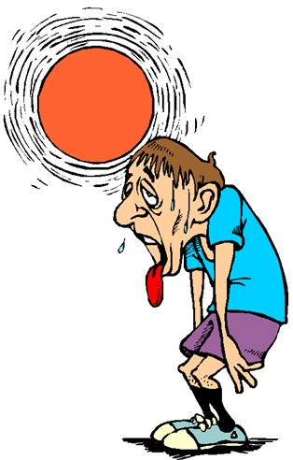
Environmental Considerations in Athletics
Sports Medicine 1

Slide 2
Athlete Specifications
Coaching and Athletic Training staff should be aware of all medical conditions of the athlete
Range from previous injuries to potentially life-threatening allergies
Staff should be adequately prepared for any and all emergency situations that may arise

Slide 3
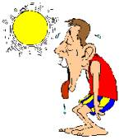
Heat Stress
Heat stress occurs when body cannot maintain homeostasis
  Body temperature rises resulting in heat-related illnesses
Hyperthermia
80% of total heat loss through skin
  Evaporation
  Perspiration
Athletes should be:
  Well hydrated
  Rested
  In good, physical condition

Slide 4
Heat Stress
Hypothalamus
  Temperature-regulating center of brain
  Responsible for controlling amount of heat lost from body
  Approx. 80% total heat loss through skin
  Regulates heat loss by changing dilation of blood vessels
Thermoregulation
  Process by which body temperature is maintained

Slide 5
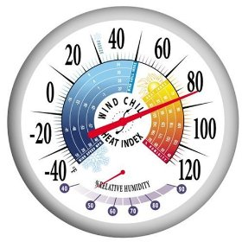
Heat Index
Reference point indicating the risk associated with outdoor exercise
Combination of air temperature & relative humidity
Calculated for conditions in shade; direct sunlight poses even greater risk
Greater heat index, more moisture in air
  Body loses its ability to adequately evaporate moisture

Slide 6
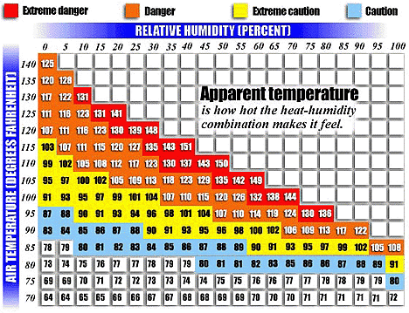
Heat Index

Slide 7
Avoid Heat-Related Illness
Prevention
Address environment
Acclimatization
Proper hydration
Weigh-ins—before & after, to determine fluid loss
Monitor at-risk athletes
Unlimited water access & timely water breaks

Slide 8
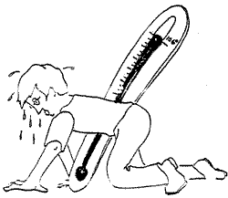
General Care of Heat Illness
Move athlete to cool location
Remove unnecessary clothing
Pour cool water over extremities
Fan athlete to increase air circulation and evaporation
Immerse athlete in cool (not cold) water
Massage extremities to promote circulation

Slide 9
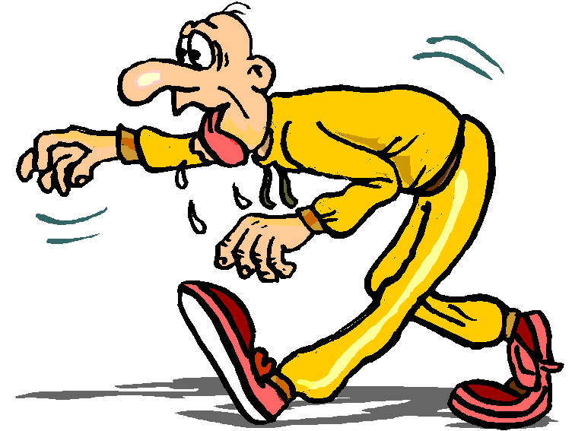
Dehydration
On average, lose 3-6 liters of water daily
Estimated one hour of exercise, demand approx. 50% increase in amount of water body uses

Slide 10
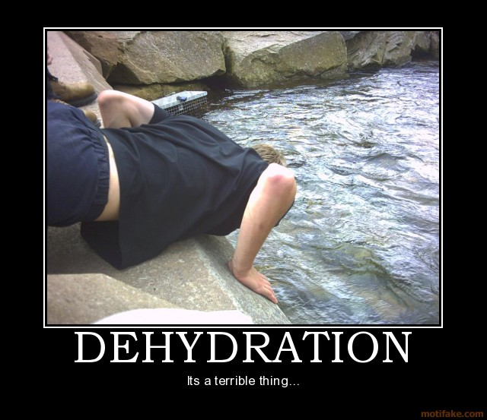
Dehydration—Signs/Symptoms
Subtle signs:
  Urine light yellow
  Mild headache
  Fatigue
  Endurance reduced
Serious signs:
  Disorientation
  Irritability
  Rapid pulse
  Complete exhaustion

Slide 11
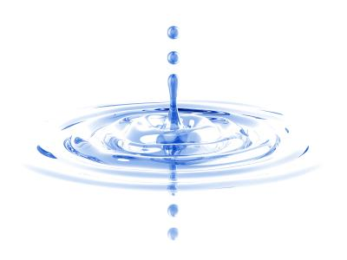
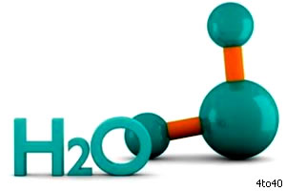
Dehydration—Signs/Symptoms
Mild
  Mucous membranes dry out
  Pulse normal
  Urine noticeably yellow
  Athlete feels mild thirst
Moderate
  Mucous membranes extremely dry
  Pulse weak and rapid
  Urine very dark
  Athlete feels very thirsty
Severe
  Mucous membranes completely dry
  Athlete disoriented & drowsy
  No urine output
  Eyes unable to make tears
  Beginning states of shock

Slide 12
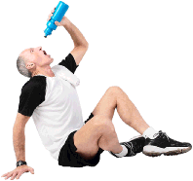
Dehydration—Treatment
NATA Fluid Replacement for Athletes
Before
  17-20 ounces (2-3 hours before activity)
  Another 7-10 ounces after warm-up
During
  28-40 ounces for every hour of play (7-10oz every 10-15 min)
After
  Rapidly replace fluid lost within 2 hours of activity
  20-24oz for every pound lost

Slide 13
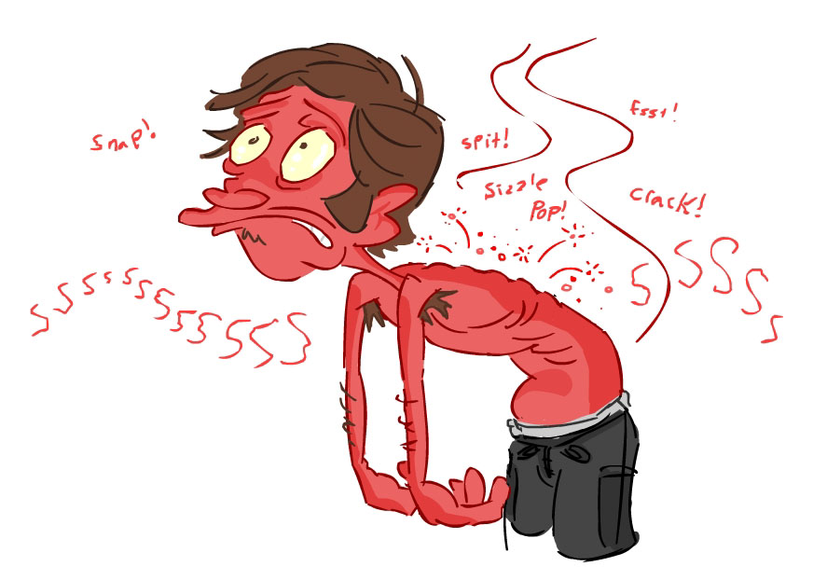
Sunburn
Injury to the skin from the sun’s rays
Can lead to skin cancer and premature aging
Those at risk include all athletes who compete outdoors including skiers and hikers
The higher the altitude, the faster a person will develop a sunburn

Slide 14

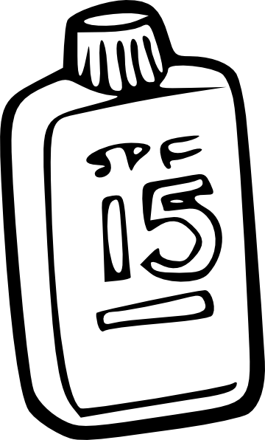
Sunburn
Treatment
Cold washcloth
Soak in cool bath
OTC pain reliever
Moisturizing lotion or aloe vera
Avoid:
  Petroleum-based products
  First-aid products that contain benzocaine
Seek medical advice for sunburn that blisters
Prevention
Sunscreen
  SPF 15 or higher
Protective clothing
Avoid sun from 10am to 4pm

Slide 15
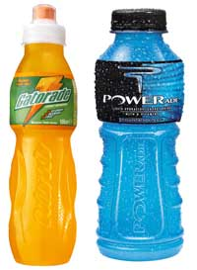
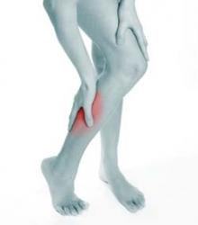
Heat Cramps
Painful, involuntary muscle spasms caused by exposure to heat and dehydration
Common; first stage of heat illness
Signs/Symptoms
Muscle cramping
Most commonly:
  Calf
  Quadriceps
  Hamstrings
  Abdominals
Treatment
Slow, passive stretching of involved muscle
Ice
Fluid & electrolyte replacement
Rehabilitation
May return to activity when symptoms subside

Slide 16
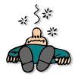
Heat Syncope
Fainting that occurs when the body attempts to cool itself by dilating the blood vessels
Signs/Symptoms
Lightheadedness
Dizziness
Headache
Nausea
Vomiting
Fainting
Treatment
Drinking fluids
Stop all activity when symptoms occur
Do not resume activity until symptoms completely subsided

Slide 17
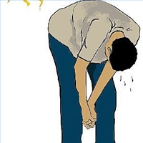
Heat Exhaustion
Mildest form of generalized heat-related illness
Condition of near body collapse
May progress to heatstroke if not treated
Signs/Symptoms
Skin: cool, moist, pale
General weakness
Dizziness
Nausea
Breathing often rapid but shallow
Pulse rapid and weak

Slide 18
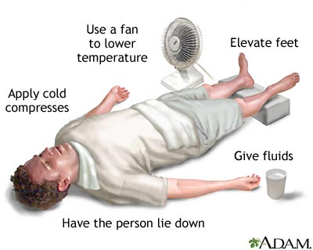
Heat Exhaustion
Treatment
Move athlete to shade
Fluid replacement vital
Cool body using ice towels
Rehabilitation
Do not return to activity
Monitor excessive weight loss

Slide 19
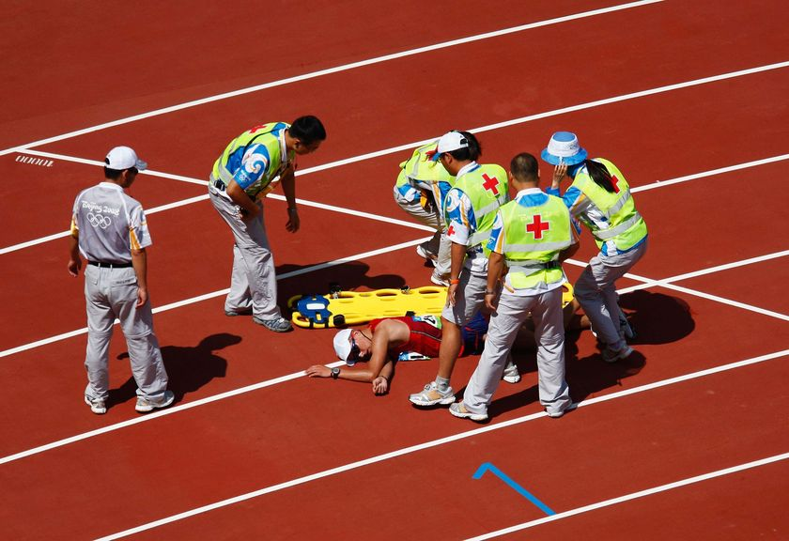

Slide 20
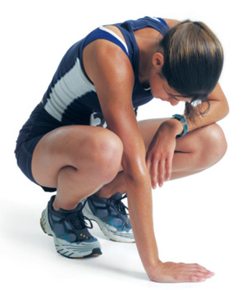

Heatstroke
Most severe heat-related condition
Life-threatening
Involves breakdown of body’s heat regulation mechanism
Signs/Symptoms
Hot, dry, red skin
Strong, rapid pulse
Mental confusion
Unconsciousness
Treatment
TRUE MEDICAL EMERGENCY
Move athlete to shade and cool immediately
Remove excessive clothing
Ice towels: axilla and groin
Mist or fan skin

Slide 21
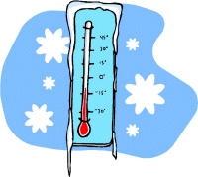
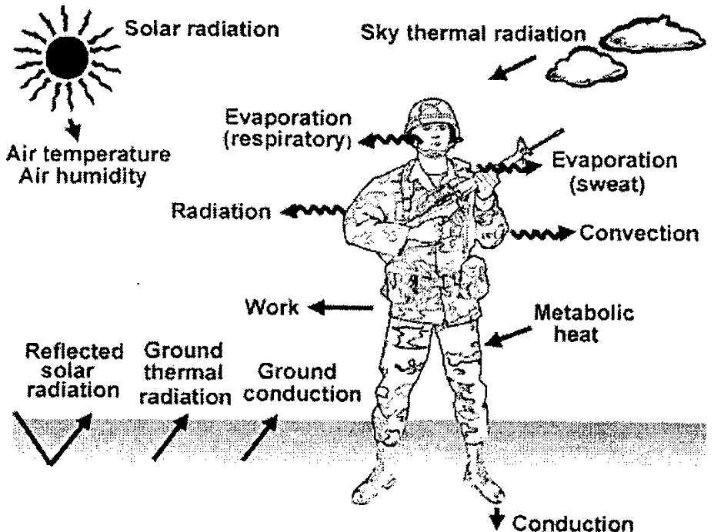
Cold Stress
The body loses heat in 5 ways:
  Respiration
  Evaporation
  Conduction
  Radiation
  Convection

Slide 22
1. Respiration
Loss of heat during exhalation
Reduced by covering mouth and nose area

Slide 23
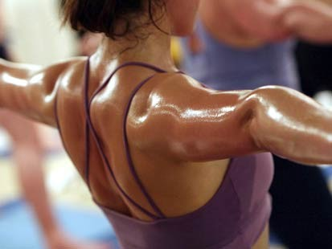
2. Evaporation
Loss of heat through perspiration
Perspiration evaporates from the skin and moisture is exhaled from the lungs
Clothing should be ventilated

Slide 24
3. Conduction
Loss of heat through transfer to a cooler object
The warmer of the two will transfer heat to the other
Examples include:
  Sitting on cold ground
  Touching cold equipment
  Swimming in cold water
  Being wet when moisture is cooler than the body

Slide 25
4. Radiation
Loss of heat through the transfer of infrared rays into the cooler environment
In direct sunlight, body absorbs radiant hear from sun
Causes greatest heat loss from uncovered skin
  head, neck, hands

Slide 26
5. Convection
Heat loss through air currents passing by a warm surface
Primary function of clothing it to keep layer of warm air next to skin, while allowing water vapor to pass through

Slide 27
Cold Stress
Four factors contribute to cold stress:
  Cold temperatures
  High or cold wind
  Dampness
  Cold water
More at risk b/c body not generate heat as quickly:
  Older people
  Medications (antidepressants, sedatives, tranquilizers, heart meds)

Slide 28
Wind Chill
Rate of heat loss from body resulting from combined effect of cold temperature and wind
Winds heat is carried away from body faster ® both skin temp and internal body temp
Can be life-threatening
Effects of wind chill depend on:
  Amount of clothing
  Additional protection
  Age
  Health
  Body characteristics

Slide 29
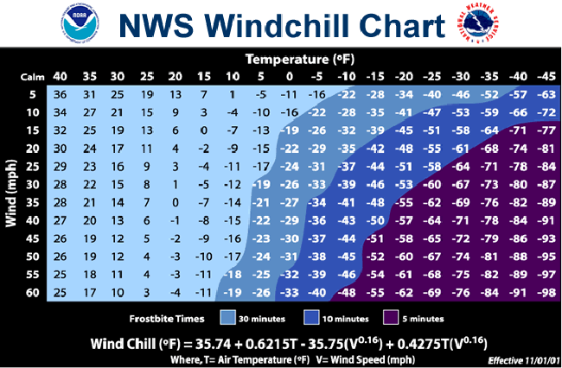

Slide 30
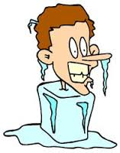
Hypothermia
Body heat is lost faster than it can be replaced
“low heat” (condition in which boy temp drops below normal)
Body’s energy used to maintain internal temps
Over time, body will begin to shift blood flow from extremities and outer skin to core
Allows exposed skin and extremities to cool rapidly, increasing risk of frostbite and hypothermia

Slide 31
Hypothermia—Signs/Symptoms
Body tem drop to 95°F
Shiver & stomp feet to generate heat
Slurred speech
Lack of coordination
Memory loss
Person will stop shivering
Body temp at 85°F→person may become unconscious
Body temp 78°F,→death may occur

Slide 32
Hypothermia—Signs/Symptoms
Onset
Individual realizes he/she is cold
Shivering may occur
  Controlled when person becomes active
Feet feel stiff
Muscles become tense
Feelings of fatigue and weakness
Coordination decreases
Skin takes on a waxy pallor
Numbness occurs

Slide 33
Hypothermia—Signs/Symptoms
Moderate
Temperature between 93°F & 95°F
Shivering less intense
Normal activity becomes uncomfortable
  Blood vessels severely constricted
Poor coordination
Trouble staying on balance
Speech may become slurred
Cannot make responsible decisions
Experience feelings of apathy & confusion
Breathing becomes shallow
Overwhelming urge to sleep

Slide 34
Hypothermia—Signs/Symptoms
Severe
Extremely weak
Skin blue
Pupils dilated
Victim may deny problem, become violent
Unconsciousness gradually takes over
Breathing so shallow, victim may appear dead

Slide 35
Hypothermia—Treatment
Do NOT place in hot water!!
Do NOT give alcohol
Do NOT wrap in electric or hot blanket
If body temp rises too fast, could induce cardiac arrest
Move individual inside
Remove wet or cold clothing
Replace with warm, dry clothes
Lie prone till medical help arrives

Slide 36
Hypothermia—Treatment
Impending
Mild
Seek or build shelter
  Get person out of cold, windy, wet environment
Start fire or stove
  Provide warmth
Provide warm drink
Insulate person with extra clothes or blankets
Removed from cold environment
  Keep head and neck covered
Provide warm, sweetened drink & high-energy food
Limit exercise

Slide 37
Hypothermia—Treatment
Moderate
Activate EMS
Remove from cold
  Keep head/neck covered
Apply mild heat to head, neck, chest, armpits, and groin
  Hot water bottles
  Warm, moist towels
Sips of warm, sweetened liquids

Slide 38
Hypothermia—Treatment
Severe
Activate EMS
Place victim in pre-warmed sleeping bag with 1-2 other people
  Skin-to-skin contact of chest and neck
  Exhale warm air near person’s nose/mouth
Apply mild heat; stop body temp dropping
Keep individual awake
If lose consciousness:
  Be gentle as heart extremely sensitive
Check for pulse at carotid artery
  If no pulse, begin CPR

Slide 39
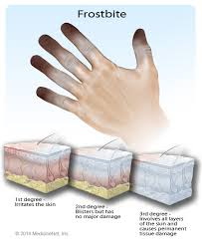
Frostbite
Skin tissue and blood vessels damaged from exposure to temps below 32°F
Commonly affects:
  Toes
  Fingers
  Earlobes
  Chin
  Cheeks
  Nose
Occurs gradually or rapidly
  Speed depends on how cold/windy and duration of exposure

Slide 40
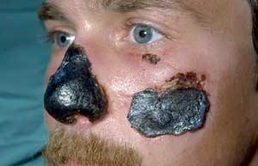
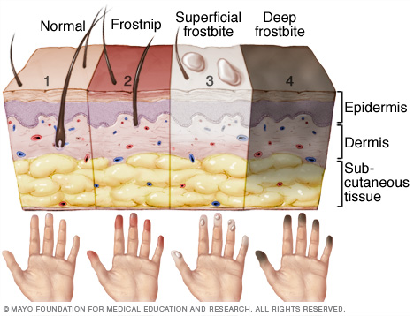

Slide 41
Frostbite—Signs/Symptoms
First Stage
Second Stage
Pins & needles sensation
Skin turns very white and soft→frostnip
No blistering
No permanent damage
Reversed by:
  soaking affected body part in warm water
  breathing warm air on affected area
Blistering may occur
Skin feel numb, waxy and frozen
  Superficial frostbite
Ice crystals form in skin cells
Skin remains flexible

Slide 42
Frostbite—Signs/Symptoms
Third Stage
Deep frostbite
Most serious
Blood vessels, muscles, tendon, nerves and bone may be frozen
Lead to:
  Permanent damage
  Blood clots
  Gangrene
No feeling experienced in affected are
No blistering
Serious infection and loss of limbs may occur

Slide 43
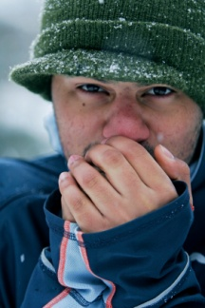
Frostbite—Treatment
Reduce Risk!
Seek emergency care if:
Wear several layers of clothing
Limit use of alcohol and smoking
Avoid going outdoors
Shield face & other body parts from wind and temperature (scarves, earmuffs, gloves, etc)
Waterproof skin moisturizer
Skin swelling
Loss of limb function
Absence of pain
Drastic skin color changes
Blisters
Slurred speech
Memory loss

Slide 44
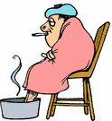
Frostbite—Treatment
Re-warming techniques:
After re-warming:
Bring individual indoors ASAP
Apply warm towels or immerse affected area in circulating lukewarm water for 20 minutes
  Never use hot water
  Area should NOT be rubbed
  If blisters present, leave intact
Do not hold affected area near fire
  Area may be burned because of reduced feeling in area
Offer individual warm fluids
Keep affected area raised
Superficial frostbite
  Skin will redden & become painful
  Blisters likely to form within 24 hours
Deep frostbite
  Skin remain hard and cool to touch
  Skin may turn black or blue
  Blisters may form
  Skin surrounding area may become swollen and remain swollen for 1+months

Slide 45
Frostbite—Healing
Avoid infection by leaving blisters intact
Watch for signs of infection
  Redness
  Swelling
  Fever
  Oozing pus
  Red streaks
Take all prescribed medications
Do not expose affect area to cold temps until cleared by physician

Slide 46
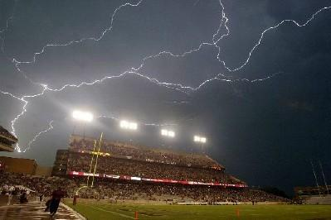
Lightning
Average stroke is 6-8 miles long
Average storm is 6-10 miles wide, travels at 25 mph
Once thunderstorm within 10 miles, you are in immediate danger of lightning strike

Slide 47
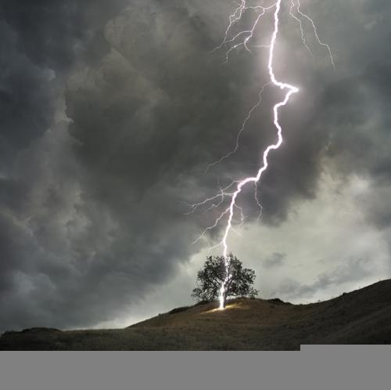
Lightning
Flash-to-Bang
  Determine distance of storm
  Count seconds between thunder & lightning
  Divide that number by 5
  Equals miles away of strike
Seek shelter
  Large, enclosed space
  Car with window rolled up
  Outside? Put feet together, crouch on balls of feet and put hands over ears
Where NOT to go:
  High, open fields
  Isolated trees
  Unprotected structures
  Rain or picnic shelters
  Dugouts
  Flagpoles
  Bleachers
  Metal fences
  Anywhere near water

Slide 48
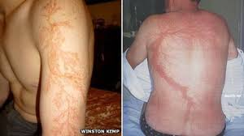
Lightning Strike Victim
DO NOT go after until danger has passed
Activate EMS
Access ABCs
Begin CPR if necessary
It is ok to touch strike victim
  They do NOT hold electrical charge!

Slide 49
Vocabulary
Heat stress
Homeostasis
Hyperthermia
Hypothalamus
Thermoregulation
Heat index
Sunburn
Heat cramps
Heat syncope
Heat exhaustion
Heat stroke
Evaporation
Conduction
Radiation
Convection
Wind chill
Hypothermia
Core body temperature
Frostbite

