Slide 1
Decontamination Procedures

Slide 2
Decontamination & Sterilization
All surfaces, tools, equipment and other objects that come in contact with blood or potentially infectious materials must be decontaminated and sterilized as soon as possible.
Equipment and tools must be cleaned and decontaminated before servicing or being put back to use

Slide 3
Decontamination
Solution of 5.25% sodium hypochlorite (household bleach)
Diluted between 1:10 and 1:100 with water
Standard recommendation is to use at least a quarter cup of bleach per one gallon of water
Use Lysol or some other EPA-registered tuberculoid disinfectant. Check the label of all disinfectants to make sure they meet this requirements

Slide 4
Medical Waste

Slide 5
Signs & Labels
Warning labels must be
placed on containers
of regulated waste,
refrigerators and freezers
containing blood or other
potentially infectious material
and other containers used to
store, transport, or ship blood
or other potentially infectious
material

Slide 6
Regulated Medical Waste
Liquid or semi-liquid blood or other potentially infectious materials
Contaminated items that would release blood or other potentially infectious materials in a liquid or semi-liquid state if compressed
Items that are caked with dried blood or other potentially infectious materials

Slide 7
Regulated Medical Waste
Red bags and sharps containers are provided for the collection of regulated medical waste
A sharps container, red bag, and storage box should be available in the Nurse’s and/or Custodian’s office

Slide 8
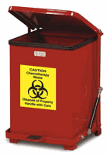
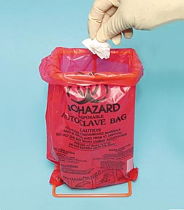
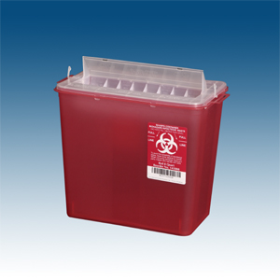
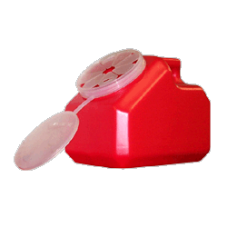
Biohazard Containers

Slide 9
Requirements for Handling Laundry
Handle contaminated laundry as little as possible, with minimal agitation
Place wet contaminated laundry in leak-proof labeled or color-coded containers before transport; use red bags or bags marked with biohazard symbol
Wear appropriate PPE when handling and/or sorting contaminated laundry

Slide 10
Employee Determination

Slide 11
Exposure Determination
Each principal/custodian/supervisor who has employees with occupational exposure must prepare an exposure determination.
Must contain:
A list of all job classifications in which all employees in those job classifications have occupational exposure
A list of job classifications in which some employees have occupational exposure

Slide 12
All Employees at Risk of Exposure
School nurses
School Aides who work with the developmentally disabled
Lifeguards
Security Guards
Health Aides
Custodial Cleaners

Slide 13
Some Employees at Risk of Exposure
Principals
Assistant Principals
Laboratory Teachers
Custodians
Designated CPR/First Aid Responders
Physical Education Teachers

Slide 14
Occupational Exposure Employees
Will receive specialized training annually
Will be offered the Hepatitis B vaccination series
Will be provided with post-exposure evaluation and follow-up in the case of an exposure incident
Will be provided with personal protective equipment

