Slide 1
Bloodborne Pathogens

Slide 2
What Are Bloodborne Pathogens?
Microorganisms such as viruses or bacteria that are carried in blood and can cause disease in people
Transmitted through contact with blood or other bodily fluids
Mode of transmission:
Human blood
Semen
Vaginal secretions
Cerebrospinal fluid
Synovial fluid

Slide 3
Bloodborne Pathogen Transmission
Bloodborne pathogens are transmitted
through contact with infected human blood
and other body fluids such as
Semen
Vaginal secretions
Cerebrospinal fluid
Synovial fluid
Pleural fluid
Peritoneal fluid
Amniotic fluid
Saliva

Slide 4
Skin Provides a Barrier
Unbroken skin forms an impervious barrier
against bloodborne pathogens. However,
infected blood can enter your system through
Open sores
Cuts
Abrasions
Acne
Any sort of damaged or broken skin such as sunburn or blister

Slide 5
Mucous Membranes
Bloodborne pathogens may also be
transmitted through the mucous membranes
of the
Eyes
Nose
Mouth

Slide 6
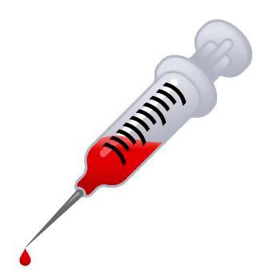
Types of Bloodborne Pathogens
Most significant—
Hepatitis B (HBV)
HIV
Also—
Hepatitis C (HCV)
Hepatitis A & D
Syphilis
Brucellosis
Malaria

Slide 7
If you are exposed…
Wash the exposed area thoroughly with soap and running water
Use non-abrasive, antibacterial soap
Flush mouth, nose, eyes for 15 minutes if blood is splashed in mucous membranes
Remove clothing that is contaminated as soon as possible & place in approved container
Report exposure to your supervisor
Fill out an exposure report form
Request blood testing & Hepatitis B vaccination

Slide 8
Hepatitis B Virus

Slide 9
Hepatitis B Virus
is a virus that causes infection and inflammation of the liver
is transmitted primarily through “blood to blood” contact
can lead to serious conditions such as cirrhosis & liver cancer
can survive in dried blood for up to seven days

Slide 10
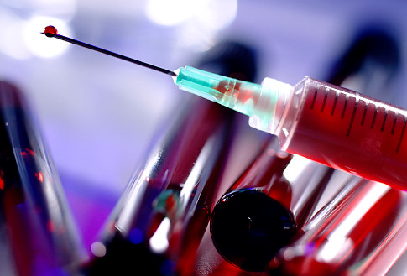
HBV Transmission
Infected blood and body fluids
In infected persons, HBV can be found in:
Blood
Body tissue
Saliva
Semen
Vaginal secretions
Urine
Breast milk

Slide 11
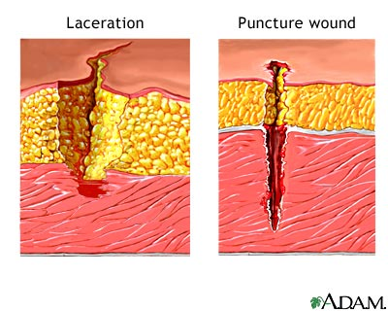
HBV Transmission in the Workplace
Puncture wounds from sharps
Contaminated body fluids entering:
An opening or break in the skin
Splashing into mucous membranes—eyes, nose, mouth

Slide 12
HBV Transmission Outside the Workplace
Unprotected sex
Intravenous drug use
(sharing needles)
Blood transfusions

Slide 13
HBV Symptoms
Mild flu-like symptoms
Fatigue
Weakness
Nausea
Abdominal pain
Headache
Fever
Possible jaundice
Darkened urine

Slide 14
Hepatitis B Vaccinations
There is no cure or specific treatment
Many people develop antibodies to fight the disease which may prevent future infection
Employees who have routine exposure to bloodborne pathogens (doctors, nurses, first aid responders, etc) shall be offered the Hepatitis B vaccine series at no cost to themselves unless:
They have previously received the vaccine series
Antibody testing has revealed they are immune
The vaccine is contraindicated for medical reasons

Slide 15
Vaccination Process
Series of three shots
Second shot is given one month after the first
Third shot follows five months after the second
This series gradually builds up the body’s immunity to the Hepatitis virus
Given in the deltoid muscle of upper arm

Slide 16
Do not take the vaccine if:
You are allergic to yeast
You are pregnant or planning to become pregnant within the year
You are ill (cold, flu, or on medication) on your appointment date
You are in doubt due to other medical issues, concerns, or complications (see your physician)

