Slide 1
Assessment & Evaluation of Sports Injuries
Chapter 11

Slide 2
Assessment and Evaluation of Athletic Injuries
Orderly collection of objective and subjective data on health status
Based on professional knowledge and knowledge of events that occurred
Knowledge of ATC helps in getting proper aid to the athlete quickly
ATC can evaluate injury, but they cannot diagnose
Licensed health care providers (i.e. MD) diagnose

Slide 3
Assessment and Evaluation of Athletic Injuries
Diagnosis
What licensed provider states to be the problem, based on skills, expertise, and training
Physician uses all information obtained to arrive at a diagnosis
ATC uses information to set short- and long-term goals for recovery

Slide 4
Assessment vs. Diagnosis
Orderly collection of objective and subjective data on the athlete’s health status
Proper assessment and evaluation of injuries after they occur, help in getting the proper aid to the athlete as quickly as possible
Using information from assessment and physical examination findings to establish the cause and nature of the athlete’s injury/disease
Made only by physician or other licensed health care provider

Slide 5
Factors Influencing Athletic Injuries
Anthropomorphic Status
Mechanism of Force
Speed
Protective Equipment
Skill Level

Slide 6
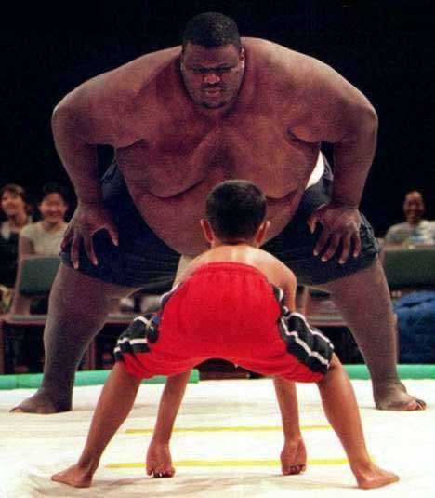
Anthropomorphic Data
Size
Weight
Body Structure
Gender
Strength
Maturity Level

Slide 7
Mechanism Of Force
Comprises all forces at time of an impact
Direction
Intensity
Duration
Activity being undertaken
Position of body/body part
Enable medical staff to get a preliminary picture of what might have been injured and to what extent

Slide 8
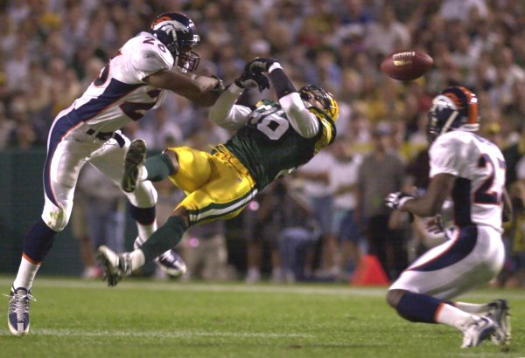
Speed
Influences type and severity of athletic injuries
Greater the speed of collision, greater the chance of injury

Slide 9
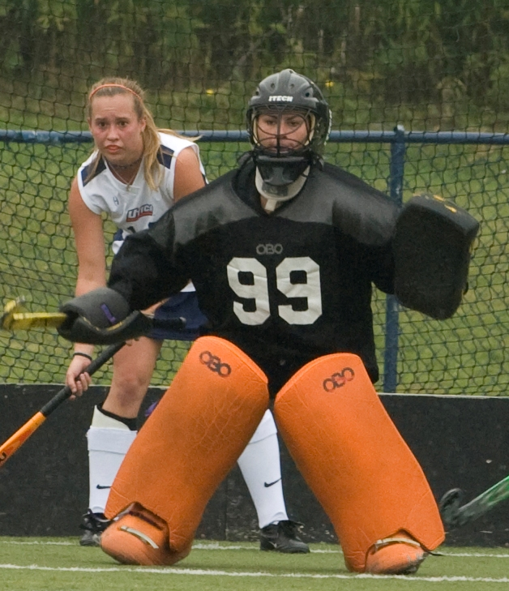
Protective Equipment & Skill
Protective Equipment
Reduces risk of injury
Absorbs an d distributes force
Skill Level
Beginners are at greater risk

Slide 10
Recognition and Evaluation
ATC determines probable cause and mechanism of injury (MOI)
May be based on direct observation or second-hand accounts
Primary Injury Survey
Assessment of life-threatening emergencies and management of ABCs
EMS should be activated in life-threatening situation
Secondary Injury Survey
A thorough , methodical evaluation of an athlete’s overall health to reveal additional injuries beyond the initial injury

Slide 11
Primary Injury Survey
Determining if injury is serious or life-threatening
ABCs
Airway
Breathing
Circulation
High-quality bystander cardiopulmonary resuscitation (CPR) can double or triple survival rates from cardiac arrest

Slide 12
Primary Injury Survey
Involves determination of serious, life-threatening injuries and the proper disposition of the injured athlete
Determines the nature, site, and severity of injury
Determines the type of first aid and immobilization necessary
Determines how the athlete should be transported from the surface of play
Determines if injury warrants immediate referral to physician

Slide 13
Secondary Injury Survey
Methodical evaluation of an athlete’s overall health
H.O.P.S. method (History, Observation, Palpation, Special tests)
Be thorough
Gather a history
Expose the injury
Perform a physical evaluation

Slide 14
Secondary Injury Survey
Be Thorough
Take your time
Look beyond the obvious
Rule out most serious injuries first
Be alert, calm, conservative, and safe
Well-being of athlete always comes first

Slide 15
Secondary Injury Survey
Be Thorough
Gather a History
Do not touch individual until all related questions have been asked

Slide 16
Secondary Injury Survey
Be Thorough
Gather a History
Expose the Injury
Injury must be exposed to observe extent of damage
Remove tape, jersey, pants if necessary
Maintain modesty

Slide 17
Secondary Injury Survey
Be Thorough
Gather a History
Expose the Injury
Perform a Physical Examination (HOPS)
Observation
Palpation
Special Tests

Slide 18
History
Give some examples of some questions you would ask an athlete about their current injury.
Your goal is use the answers to predetermine the diagnosis in order to organize your steps for the evaluation.

Slide 19
History
What happened? Body part injured; description of injury
When did it occur?
What factors influenced the injury?
Position of body & injured area
WB or NWB
Activity at time of injury?
Speed/direction of force?
Intensity & duration of force
Results of force—twisting, hyperextension/flexion

Slide 20
History continued
Was a sound heard? By individual or anyone else? Pop, snap, rip?
Where is pain located now? Where was it located at time of injury? Have athlete point to pain with one finger.
Pain characteristics:
sharp or dull/achy?
Constant, cramping, intermittent?
Painful at rest or only with use?
How intense is pain? 1-10 scale

Slide 21
History continued
Is neurological function intact?
Numbness, pins-&-needles, prickling, muscle weakness, paralysis, burning sensation
Is there any instability? A sense that something isn’t working right?
Prior history of injury to this body part?

Slide 22
Observation
Look & compare to uninjured side
Specifically look for:
Swelling
Discoloration (vascular problems or bruising)
Deformity (dislocation and/or fracture)
Bleeding

Slide 23
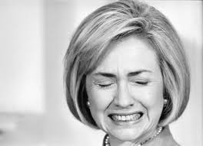
Palpation
Touching of injured athlete
Examine uninjured side first
Observe athlete’s face for signs of wincing
Feel for bones, ligaments, muscles, and tendons

Slide 24
Range of Motion (ROM) & Strength
Active (AROM)
Movement done by athlete
Passive (PROM)
Movement done by examiner
Resisted (RROM)
Movement done by athlete while examiner applies resistance
Manual Muscle Test (MMT)/Break Test

Slide 25
Special Tests
Special tests/exams establish degree of injury
Stability tests investigate ligamentous laxity
Grade 1
Grade 2
Grade 3

Slide 26
Ligamentous Laxity
Grade 1: few torn fibers that will make maneuver painful, but not show any ligamentous laxity compared to uninjured side
Grade 2: produce both pain and increased ligamentous laxity; will be endpoint
Grade 3: may or may not be pain; will be complete instability of joint; marked looseness that joint can be dislocated; complete tear of ligament; no end point

Slide 27
Functional Activity
Level of movement at which the athlete can comfortably work and participate
Passed various tests
Demonstrate normal inspection
Minimal pain upon palpation
Full ROM
Full muscle strength vs resistance
Joint stability
Athlete stand, walk, hop, jog, sprint, cut, twist
Sport-specific activities
Notes:
ATC determines what level of activity to permit during treatment/rehab

Slide 28
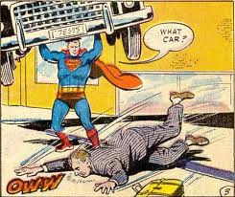
Return-to-Play Criteria
Full strength
All muscles supporting the injury must be at 100% of pre-injury strength prior to RTP
Damage to surrounding soft tissue must be healed

Slide 29
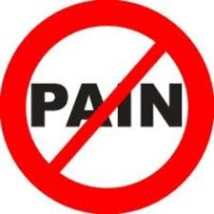
Return-to-Play Criteria
Full Strength
Free from pain
Athlete in pain is athlete at risk for significant injury
True pain is indication that injury has not completely healed
No pain during performance test for RTP

Slide 30
Return-to-Play Criteria
Full Strength
Free from pain
Skill performance tests
Tests designed to simulate actual skills required for sport
Begin at low level of intensity, gradually increase until athlete performing at game speed
May include sprinting, jumping, cutting, back-pedaling, pushing, etc

Slide 31
Return-to-Play Criteria
Full Strength
Free from pain
Skills performance test
Emotional readiness
Counseling will help athlete work through any hesitation about returning to play after sustaining injury
Athlete who do not perform at 100% will be prone to new injuries
Always ask the athlete if they are ready
An athlete who is hesitant or does not feel ready should not be allowed to return

Slide 32
Documentation of Injuries
SOAP vs HOPS
Daily Injury Report
Training-Room Treatment Log
Daily Red-Cross List
Athlete Medical Referral Form

Slide 33
SOAP
Subjective
Statements made by injured athlete
History taking (time, mechanism, injury site)
Objective
Assessment
Plan

Slide 34
SOAP
Subjective
Objective
Visual inspection
palpation,
assessment of active, passive, resistive motion
Special tests performed
Assessment
Plan

Slide 35
SOAP
Subjective
Objective
Assessment
ATCs personal judgment & impression as to nature and extent of injury
Plan

Slide 36
SOAP
Subjective
Objective
Assessment
Plan
First aid treatment rendered to athlete
Disposition (what is done next)
Include treatment and therapeutic exercises

Slide 37
HOPS
SOAP
History
Observation
Palpation
Special Tests
Subjective
Objective
Assessment
Plan

Slide 38
The Body’s Response to Injury
Chapter 16
Pages 333-335

Slide 39
Inflammation
Reaction to invasion by an infectious agent or physical, chemical, or traumatic damage
Response due to minor or major injuries
Body must respond to injury by healing and repairing the damaged tissue
Eliminate infectious agents and their toxins

Slide 40
Inflammatory Response
Oldest defense mechanism
Concentration of immune-system cells and their products at the site of damage
3 major events occur:
Blood supply to damaged tissue increases
Capillary permeability increases
Leukocytes migrate out of capillaries into surrounding tissues

Slide 41
Cell Regeneration
Act of wound healing
Once tissue is degraded by leukocytes, generation of new tissue can begin
Damaged tissue may be replaced by scar tissue (fibrous connective tissue that binds to damaged tissue)

Slide 42
Cellular dedifferentiation
Regeneration
Cells revert to an earlier stage of development
Transdifferentiation
Regeneration of cells with completely different functions than original
Tissue remodeling
Cells and molecules of tissue are modified and reassembled to yield a new composition of cell types and extracellular matrix

Slide 43
Tissue Remodeling
4 components to process of extracellular matrix
Formation of new blood vessels
Migration and proliferation of fibroblasts to fill and bridge wound
Deposition of ECM
Tissue remodeling, maturation and reorganization of fibrous tissue into a scar

Slide 44
Tissue Remodeling cont.
Remodeling phase can last 1 year +
Collagen fibers thickened and strengthened
Tensile strength of wound increases as collagen molecules modified and cross-linked by enzymes

Slide 45
Phases of Soft Tissue Injury

Slide 46
Phases of Soft Tissue Injury
Acute Inflammatory Phase
Repair and Regenerative Phase
Remodeling Phase

Slide 47
Acute Inflammatory Phase
Outward Signs:
Redness
Pain
Swelling
Increased tissue temperature
Loss of function
Pain Due To:
Specific chemical substances
Pressure on nerve endings
Lack of oxygen to area resulting in death of tissues

Slide 48
Acute Inflammatory Phase
Vasoconstriction followed by vasodilation
Vasoconstriction
Initially & up to 10 minutes
Seals blood vessels
Activates chemicals
Decreases blood flow to area
Vasodilation
Slowing of blood’s flow
Increase in blood viscosity (thickness)
Blockage of circulation

Slide 49
Results of Vasodilation
Swelling
Accumulation of plasma and RBC
Vessel lining becomes more permeable so there is more fluid accumulation
Redistribution of leukocytes
Bring anticoagulant substance
Ingest small debris
Margination (pavementing)
Lineup and adhere to endothelial wall (setting stage for scar)

Slide 50
Repair & Regeneration Phase
Repair
Synonymous with healing
Regeneration
Refers to restoration of destroyed or lost tissue
Healing occurs when the area become clean through the removal of cellular debris, erythrocytes, and fibrin clot

Slide 51
Repair & Regeneration Phase
Formation of scar tissue is common
The less scaring the better the end result
Mature scar tissue is firm, fibrous, inelastic, devoid of capillary circulation
Tissue repair accomplished

Slide 52
Remodeling Phase
First 3-6 weeks
Increase in production of scar tissue
Increase in strength of fibers
Ligaments take up to one year to complete the remodeling phase
Tensile strength of collagen is specific to the mechanical force imposed during the remodeling phase

Slide 53
Remodeling Phase
Force applied during rehab = strength
Too early or too excessive of rehab results in delayed and extended healing
MUST balance synthesis and lysis (building up and breaking down)

Slide 54
Length of Phases Based On:
Medication
Immediate action taken
Forces on injury
Tissue damaged
Vascularity

