Slide 1
Anatomical Terminology

Slide 2
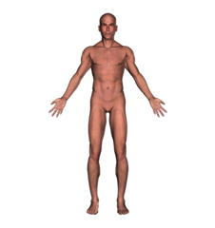
Anatomical Position
Arms down by side
Palms up
Head and eyes forward
Legs parallel, feet together

Slide 3
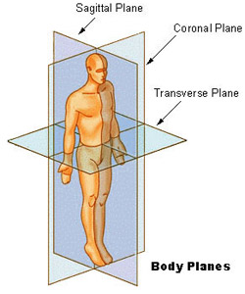
Coronal/Sagittal/Transverse Planes
Coronal Plane (Frontal Plane)
Sagittal Plane (Lateral Plane)
Transverse Plane (Axial Plane)

Slide 4
Coronal Plane
aka Frontal Plane
Vertical plane running from side to side
Divides the body or any of its parts into anterior and posterior portions

Slide 5
Sagittal Plane
aka Lateral Plane
vertical plane running from front to back
Divides the body or any of its parts into right and left sides

Slide 6
Transverse Plane
aka Axial Plane
Horizontal plane
Divides the body or any of its parts into upper and lower parts

Slide 7
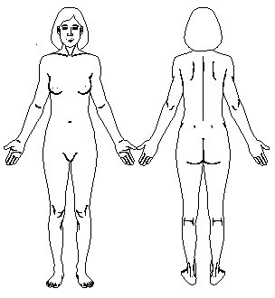
Anterior/Posterior
Anterior— to be situated near or toward the front of the body
Posterior-- to be situated toward the back of the body

Slide 8
Superior/Inferior Cranial/Caudal
Superior— means to be situated toward the upper part or head of the body, positioned above another organ or structure
Inferior— to be situated toward the lower part of the body or positioned below another organ or structure
Cranial—refers to the head end
Caudal—refers to the tail end

