Slide 1
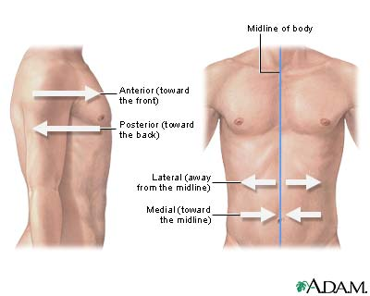
Medial/Lateral
Medial— to be closer to the midline of the body or a structure, being internal as opposed to external
Lateral— to be farther away, in the direction of either side, from the midline of the body or a structure

Slide 2
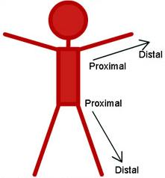
Proximal/Distal
Proximal: Toward or nearest the trunk or the point of origin of a part
Distal: Away from or farthest from the trunk or the point of origin of a part

Slide 3
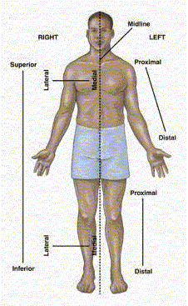

Slide 4
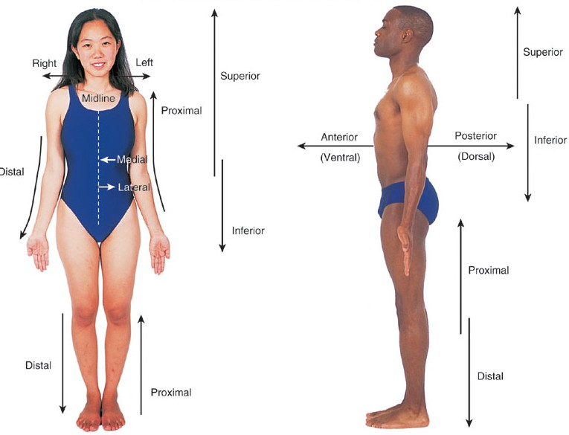

Slide 5
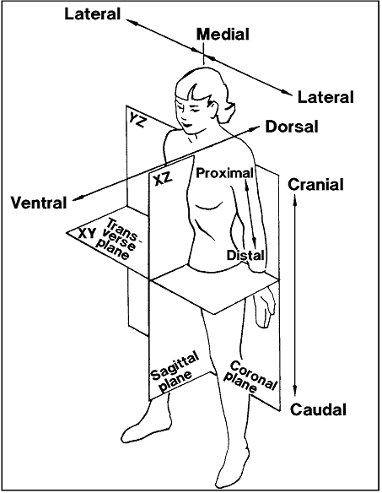

Slide 6
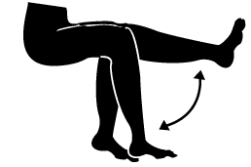
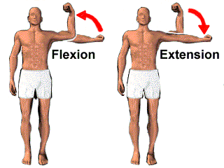
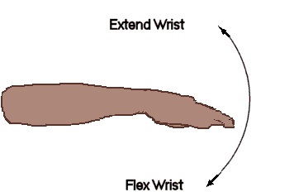
Flexion/Extension

Slide 7
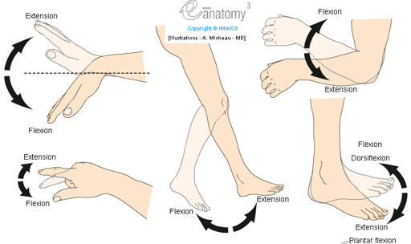

Slide 8
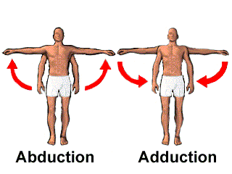
Abduction/Adduction
Abduction— moving a body part away from midline
Adduction— moving a body part toward the midline

Slide 9
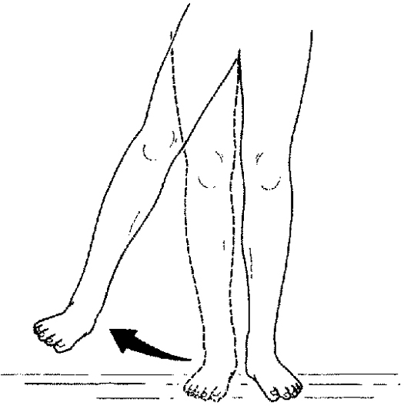
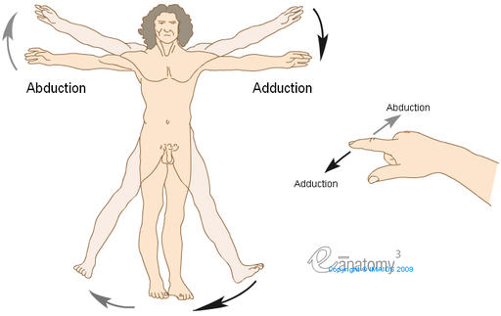
Abduction/Adduction

Slide 10
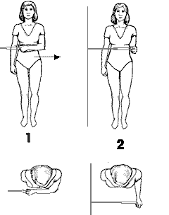
Internal/External Rotation
Internal rotation— rotation towards the center of the body
aka medial rotation
External rotation— rotation away the center of the body
aka lateral rotation

Slide 11
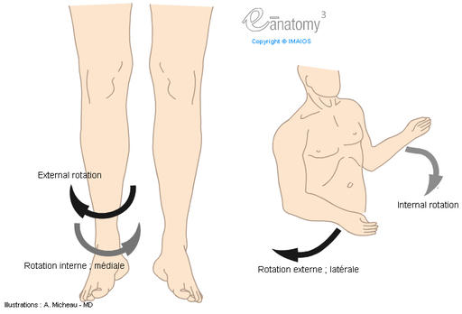
Internal/External Rotation

Slide 12
Hip Internal Rotation

Slide 13
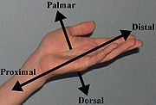
Hand: Dorsal/Palmar

Slide 14
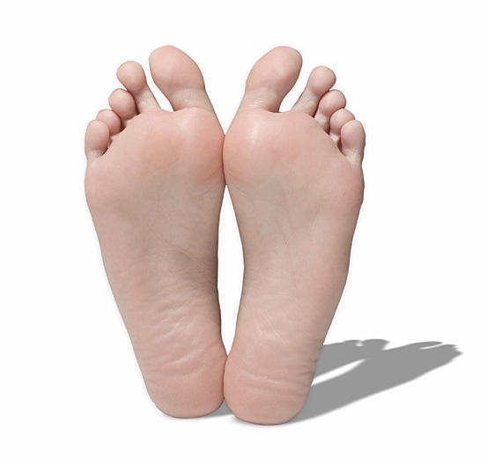
Foot: Dorsal/Plantar

Slide 15
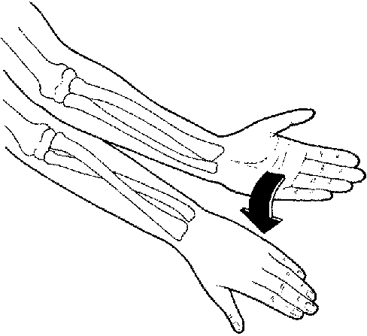
Supination/Pronation

Slide 16
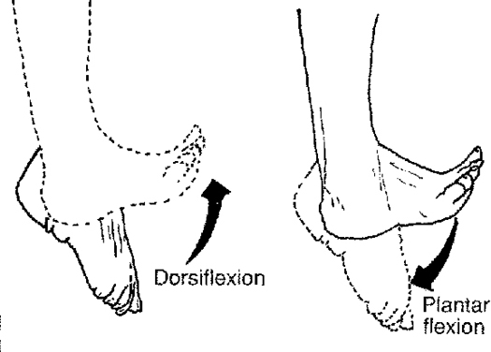
Plantar Flexion/Dorsiflexion

Slide 17
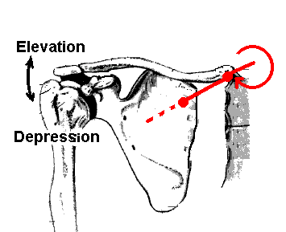
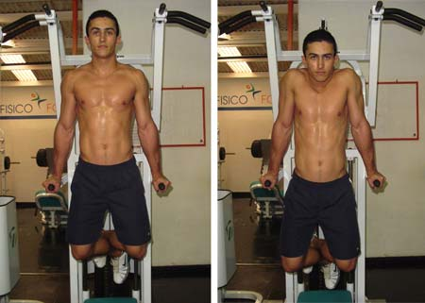
Elevation/Depression

Slide 18
Inversion/Eversion

Slide 19
Unilateral/Bilateral
Unilateral—on one side
Bilateral—on both sides

Slide 20
Acute/Chronic
Acute—symptoms appear and change/worsen rapidly (heart attack)
Chronic—develops and worsens over an extended period of time (atherosclerosis)
Notes:
Atherosclerosis: a common arterial disease in which raised areas of degeneration and cholesterol deposits plaques form on the inner surfaces of the arteries obstructing blood flow

